Slide 1


Software Engineering
Cheng Xie

Slide 2
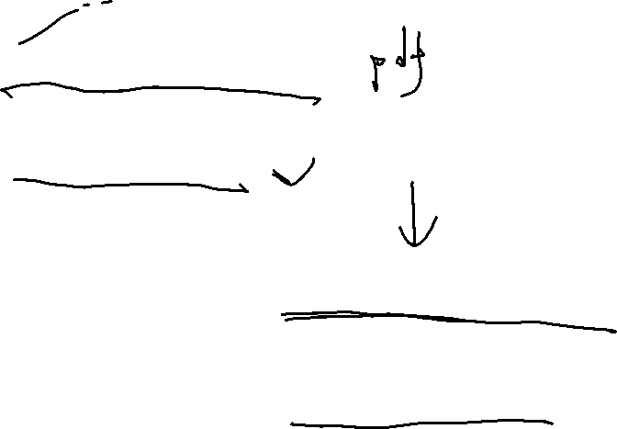


TextBook
Software Engineering
10th edition
Ian Sommerville
Software Engineering
7th edition
Roger S. Pressman

Slide 3
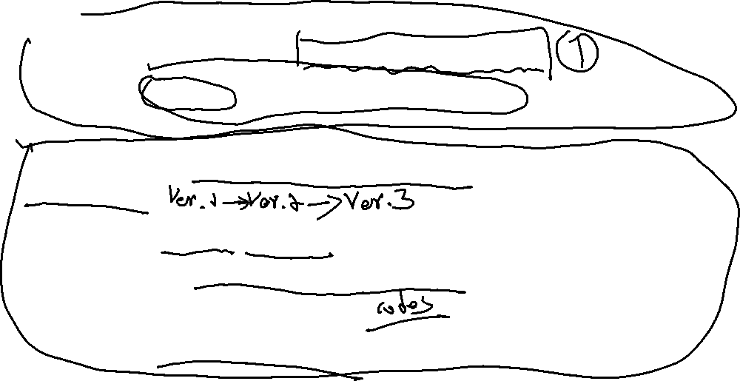
Course Objective
To know the theory of software engineering
To use a process of software engineering to conduct a project.
To make a requirement document for the project iteratively
To make a design document for the project iteratively
To make a development document for the project iteratively
To make a runnable software iteratively

Slide 4
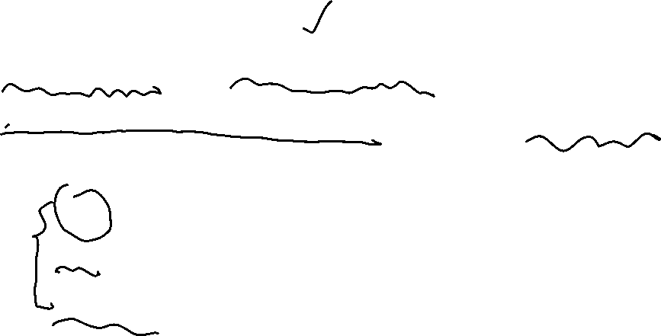
Requirement document
General description.
Functional and non-Functional requirements
Requirements specification (for each functional requirement)
NL specification
SL specification
Tabular specification

Slide 5
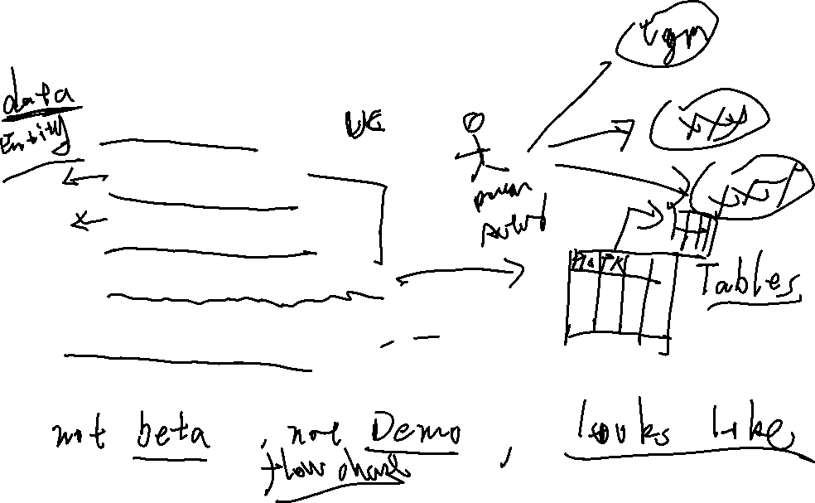
Design document
Architectural Design (Chapter 11)
Object-oriented Design(Chapter 14)
Use Cases
E-R diagram
Class diagram
Database diagram
Prototype views (Chapter 16)
Process diagram for the functional requirement

Slide 6
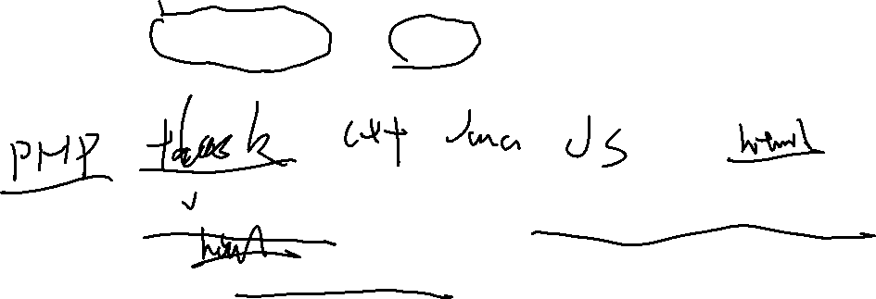
Implementation document
The main code for each functional requirement
（only the business code, but no need the UI code）
The screenshot of for each functional requirement
(Only the UI screenshot, no need the other things)

Slide 7

Runnable Software
A runnable software
A readme file to show how to run your software
The source code of your software

Slide 8
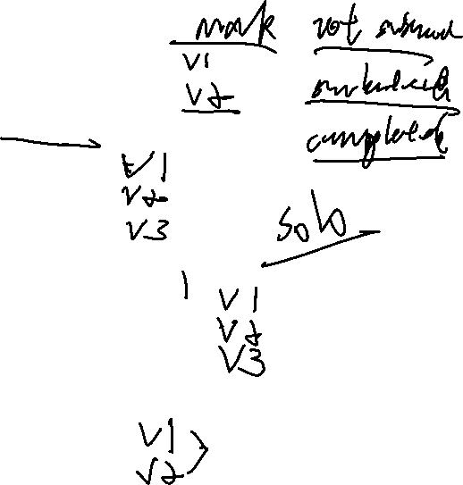
Course Plan
Week 1: Show you the project. Software Requirement (chapter 6)
Week 2: Requirement Engineering (Chapter 6-7)
Week 3: check the Requirement Document Iteration 1
Week 4: check the Requirement Document Iteration 2
Week 5-7: Software Design (Chapter 11, 14, 16)
Week 8: check the Design Document Iteration 1
Week 9: check the Design Document Iteration 2
Week 10: check the Design Document Iteration 3
Week 11-12: Rapid software development (Chapter 17, 23)
Week 13: check the Development Document Iteration 1
Week 14: check the Development Document Iteration 2
Week 15: check the Development Document Iteration 3
Week 16：Software cost estimation (Chapter 26)
Week 17: check the Runnable Software Iteration 1
Week 18: check the Runnable Software Iteration 2

Slide 9

Grading
Attendance : 20%
Project: 80%
Order | Delivery | Proportion
1 | Requirement Document | 20%
2 | Design Document | 30%
3 | Development Document | 20%
4 | Runnable Software | 30%

